Slide 1
Access Control Systems & Methodology
Lecture 3
Asad Raza
asadraza@mcs.edu.pk

Slide 2
Recommended Reading
Chapter 4 : CISSP
Chapter 2 & 3 of Computer Security by Dieter Gollmann

Slide 3
Overview
Identification
Authentication
Authorization
Access Controls Models
Mandatory
Discretionary
Non-Discretionary
Single Sign-On Technologies
Threats and Attacks on Different Technologies

Slide 4
Access Control Fundamentals
First Line of Logical Protection
Access control is the first line of protection of a company’s assets and several technologies are used.

Slide 5
Access Control Fundamentals
Subject & Object
Subject is an active entity attempting to access an object. Object is a passive entity being accessed.
Something can be a subject and an object at the same time.
Subjects can be users, applications, & processes in an operating system, or computers accessing other computers.

Slide 6
Access Control Fundamentals
Identification
Stating who I am.
Authentication
Verifying the identification of a subject.
Identification is usually public information but authentication should be private and protected.
Authorization
Assigning rights and permissions, which allows a subject to carry out its tasks.

Slide 7
Access Control Fundamentals
All the authentication technologies and techniques have the same goal of verifying a subject’s identity.
Include:
Biometrics
Passwords
Token Devices
Cryptographic Keys
Memory and Smart Cards

Slide 8
Access Control Fundamentals
Authentication Technologies characterized by:
Something you know
Something you have
Something you are
Any authentication technology will have at least one of these characteristics.
Strong authentication, also called two-factor authentication, has 2 of these 3 characteristics.

Slide 9
Biometrics
Biometrics reviews individuals’ physical attributes, voice print, fingerprint and retina scan.
Biometrics technology is becoming more accepted, but is one of the most intrusive authentication mechanisms.

Slide 10
Biometrics- Working
Enrollment Phase:
Generates a reference file used for future authentication purposes.
Authentication Phase:
Compares the data now collected with what is stored in the reference file.
System Calibration

Slide 11
Biometrics
Sensitivity allows for errors:
Type I → False Rejection
One who should be authorized is rejected.
Type II → False Acceptance
An imposter is improperly authenticated.

Slide 12
Biometrics
The most dangerous type of errors are Type II.
Does that mean Type I errors are acceptable?
A CER is used to understand the accuracy between several different biometric systems.
The lower the CER value, the higher the accuracy.
A CER value of 2 is more accurate than a CER value of 3.

Slide 13
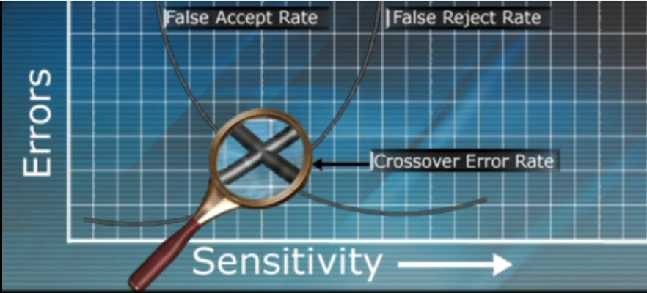
Biometrics
Crossover Error Rate (CER)
A metric used to gauge a biometric system’s accuracy.

Slide 14
Biometrics
Companies have a wide range of choice when it comes to different types of biometric systems.

Slide 15

Biometrics
Finger Scan & Fingerprint
A finger scan collects less information than a fingerprint and requires fewer resources.

Slide 16

Biometrics
Hand Geometry
Reviews the length and width of your hand and fingers from a top view.

Slide 17

Biometrics
Iris Scan
Reviews the color portion and patterns around the pupil of an eye.

Slide 18
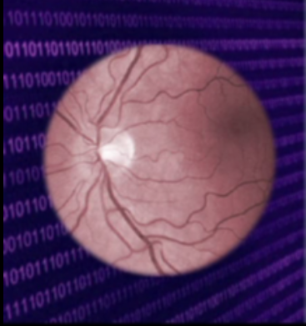
Biometrics
Retina Scan
Review the pattern of blood vessels at the back of an eyeball.

Slide 19
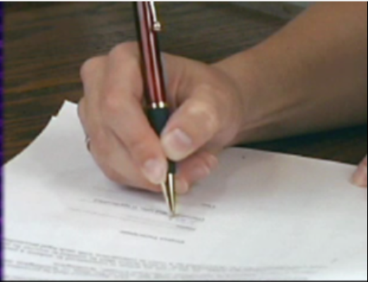
Biometrics
Signature Dynamics
Different than a Digitized Signature which is an electronic copy of a static signature.
Captures many features of how one writes, making it harder to forge a signature.
Signing signatures produces
electrical signals that can be
captured

Slide 20
Biometrics
Voice Print
Captures the frequency and pitch of a voice for authentication.

Slide 21
Passwords and their Management
Passwords are the most common authentication mechanism used because they are the easiest --- But the least secure.

Slide 22
Passwords and their Management
Passwords should be at least 8 characters (alphanumeric and symbols), upper and lower case.
User should not be able to use same password
Password history
Threshold (Clipping Level) of acceptable number of failed login attempts.
Passwords should not be shared
Do not use easily guessed or dictionary words.

Slide 23
Passwords and their Management
A dictionary attack compares a captured password to words in a file.
A brute force attack tries different characters until a match is found.
Tools can be configured to execute both types of attacks.

Slide 24
Passwords and their Management
Tools are used to uncover captured passwords for white or black hat purposes.
Cognitive passwords are based on an individual’s opinions and life experiences.
Password generators create very complex passwords that people will most likely write down.

Slide 25
Token Devices
Token devices are used to generate one-time passwords.
The one-time password is used for authentication and provides more protection than static passwords.

Slide 26
Token Devices
Two types:
Synchronous: based on time or counter
Asynchronous: based on challenge-response

Slide 27
Token Devices
Time-Based Synchronous Token Devices
The token device and authentication service must have the same internal time.

Slide 28
Token Devices
Asynchronous Token Devices
Asynchronous token devices have more steps involved for a user to be authenticated
Challenge-Response
The password itself is not sent over the wire in a challenge-response authentication technology.

Slide 29
Token Devices
Both synchronous and asynchronous token devices generate one-time passwords for authentication.
It is harder for an attacker to reuse a one-time password than a static password.

Slide 30
Token Devices
An example of something you have
Some token devices require user to authenticate himself to the device. E.g. by a pin number
2-factor Authentication

Slide 31
Cryptographic Keys
Another way to authenticate a subject.
In Public key cryptography, private key is used for authentication.

Slide 32
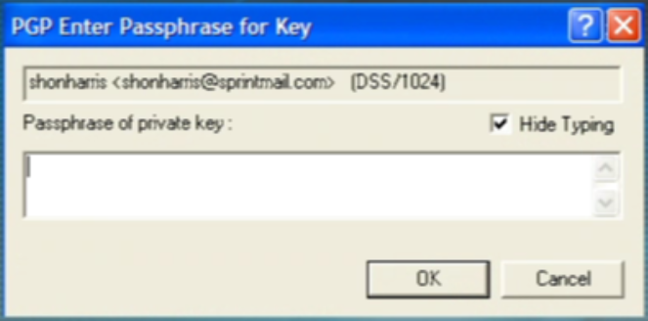
Passphrase
A passphrase provides more protection than a password because it is longer.
A passphrase is converted into a virtual password.

Slide 33
Memory and Smart Cards
A memory card has a magnetic strip that holds data but it cannot process data.
A smart card has a microprocessor and integrated circuits that process data instead of just holding data.
A smart card can hold money, medical information, or a private key.
A smart card can generate a one-time password and respond to a challenge-response.

Slide 34
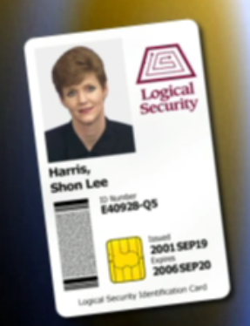
Memory and Smart Cards
The smart card uses the gold seal input/output connection channel to communicate with the reader.

Slide 35
Memory and Smart Cards
Smart cards can have biometric templates to hold biometric reference files for authentication.

Slide 36
Access Criteria
What subjects can access what objects?
Subjects must supply access criteria information before it can be authorized to access an object.
Clearances and Classifications

Slide 37
Access Criteria
Need-to-know authentication restricts access from the resources not required to carry out tasks.
Data is compartmentalized into specific categories and subjects are granted access to them.
Access criteria can be broken up into
Roles
Groups
Location
Time
Transaction type

Slide 38
Access Criteria
Least privilege authentication restricts access to only those resources required for the task.
Authorization Creep: More rights and permissions are given to users over time as positions and roles change.

Slide 39
Access Criteria
Default to no access means that if a subject has not been explicitly allowed it is implicitly denied.

Slide 40
Access Criteria
Separation of duties means that a critical task cannot be carried out by an entity alone.
It is dangerous to trust individual subjects so important tasks should be split among several subjects.
Key recovery is an example of separation of duties.
Collusion is when more than one person comes together to carry out fraudulent activity.

Slide 41
Single Sign-On Technologies
Single Sign-on Technologies allow user one-time authentication and access to all necessary resources.

Slide 42
Single Sign-On Technologies
Help reduce the amount of credential sets users have to keep track of.
Reduce administrative overhead involved with authentication issues.
If an attacker obtains one credential set, he/she has the Keys to the Kingdom.

Slide 43
Single Sign-On Technologies
Single Sign-on is an immature technology with hurdles to overcome to work in different environments.

Slide 44
Single Sign-On Technologies
Kerberos
SESAME
Thin Clients
Scripts
Directory Services

Slide 45
Kerberos

Slide 46
Introduction
Kerberos is a three-headed dog
A network authentication protocol developed at MIT as part of Project Athena Kerberos is also known as Cerberus, when using the Latin spelling
Uses private-key cryptography for providing authentication across open networks
Mediates authentication through a trusted 3rd party

Slide 47
Three Heads
● Authentication
– The confirmation that a user who is requesting services is a valid user of the network services requested
● Authorization
– The granting of specific types of service to a user, based on their authentication, what services they are requesting, and the current system state
● Accounting
– The tracking of the consumption of network resources by users

Slide 48
Advantages
Standards-based strong authentication
Broad operating-system support
Provides for single sign-on (SSO) capability
Passwords never traverse the network
Password guessing more difficult
Stolen authentication tickets are hard to reuse

Slide 49
Summary of Kerberos Version 4 Messages Exchange
(1) C to AS IDc||IDtgs||TS1
(2) AS to C E(Kc,[Kc,tgs||IDtgs||TS2||Lifetime2||Tickettgs])
(3) C to TGS IDv||Tickettgs||Authenticator c
(4)TGS to C E(Kc,tgs, [Kc,v||IDv||TS4||Ticketv])
(5) C to V Ticketv||Authenticator c
(6) V to C E(Kc,v, [TS5 + 1]) (for mutual authentication)
Tickettgs = E(Ktgs, [Kc,tgs||IDC||ADC||IDtgs||TS2||Lifetime2])
Ticketv = E(Kv, [Kc,v||IDC||ADC||IDv||TS4||Lifetime4])
Authenticatorc = E(Kc,tgs, [IDC||ADC||TS3])

Slide 50
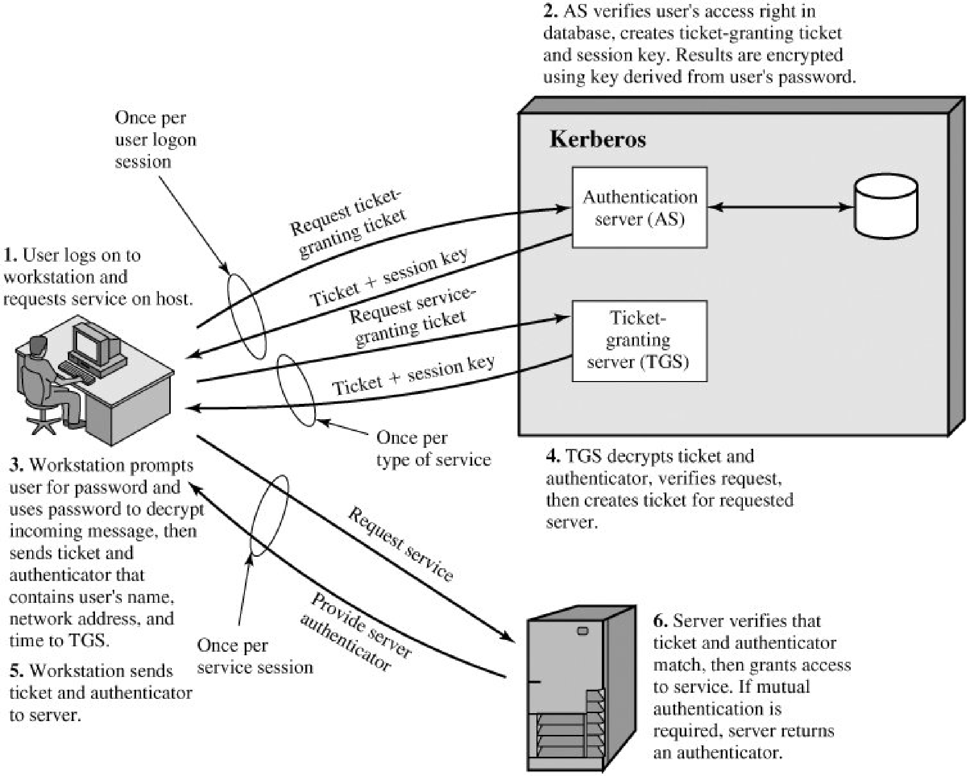

Slide 51
Kerberos Realms and Multiple Kerberi
A Kerberos environment consists of
Kerberos server
Number of clients
Application servers
Requirements
The Kerberos server must have the user ID and hashed passwords of all participating users in its database. All users are registered with the Kerberos server.
The Kerberos server must share a secret key with each server. All servers are registered with the Kerberos server
A Kerberos realm is a set of managed nodes that share the same Kerberos database

Slide 52
Weaknesses in Kerberos ?

Slide 53
SESAME (Secure European System for Applications in a Multi-vendor Environment)
A single sign-on technology based on public and private key cryptography.
Also vulnerable to password guessing attacks.
Uses tokens, Privileged Attribute certificates (PACs), and digital signatures.
PACs are signed by PAS

Slide 54
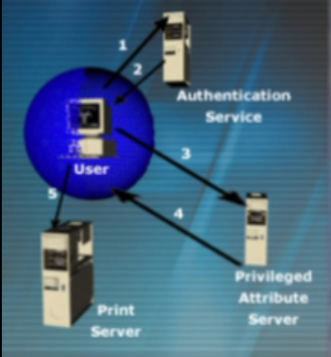
SESAME

Slide 55
Thin Clients/ Dumb Terminals
User authenticates to a thin client.

Slide 56
Scripts
Logon scripts automate the same steps users would carry out manually.
Logon scripts can provide security risks because all the credentials are stored within one file.

Slide 57
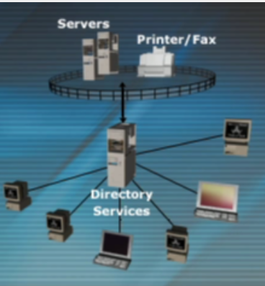
Directory Services
Directory services has a database of users and resources and controls resource access and allocation.
Examples
LDAP
NDS
Microsoft Active Directory

